Slide 1
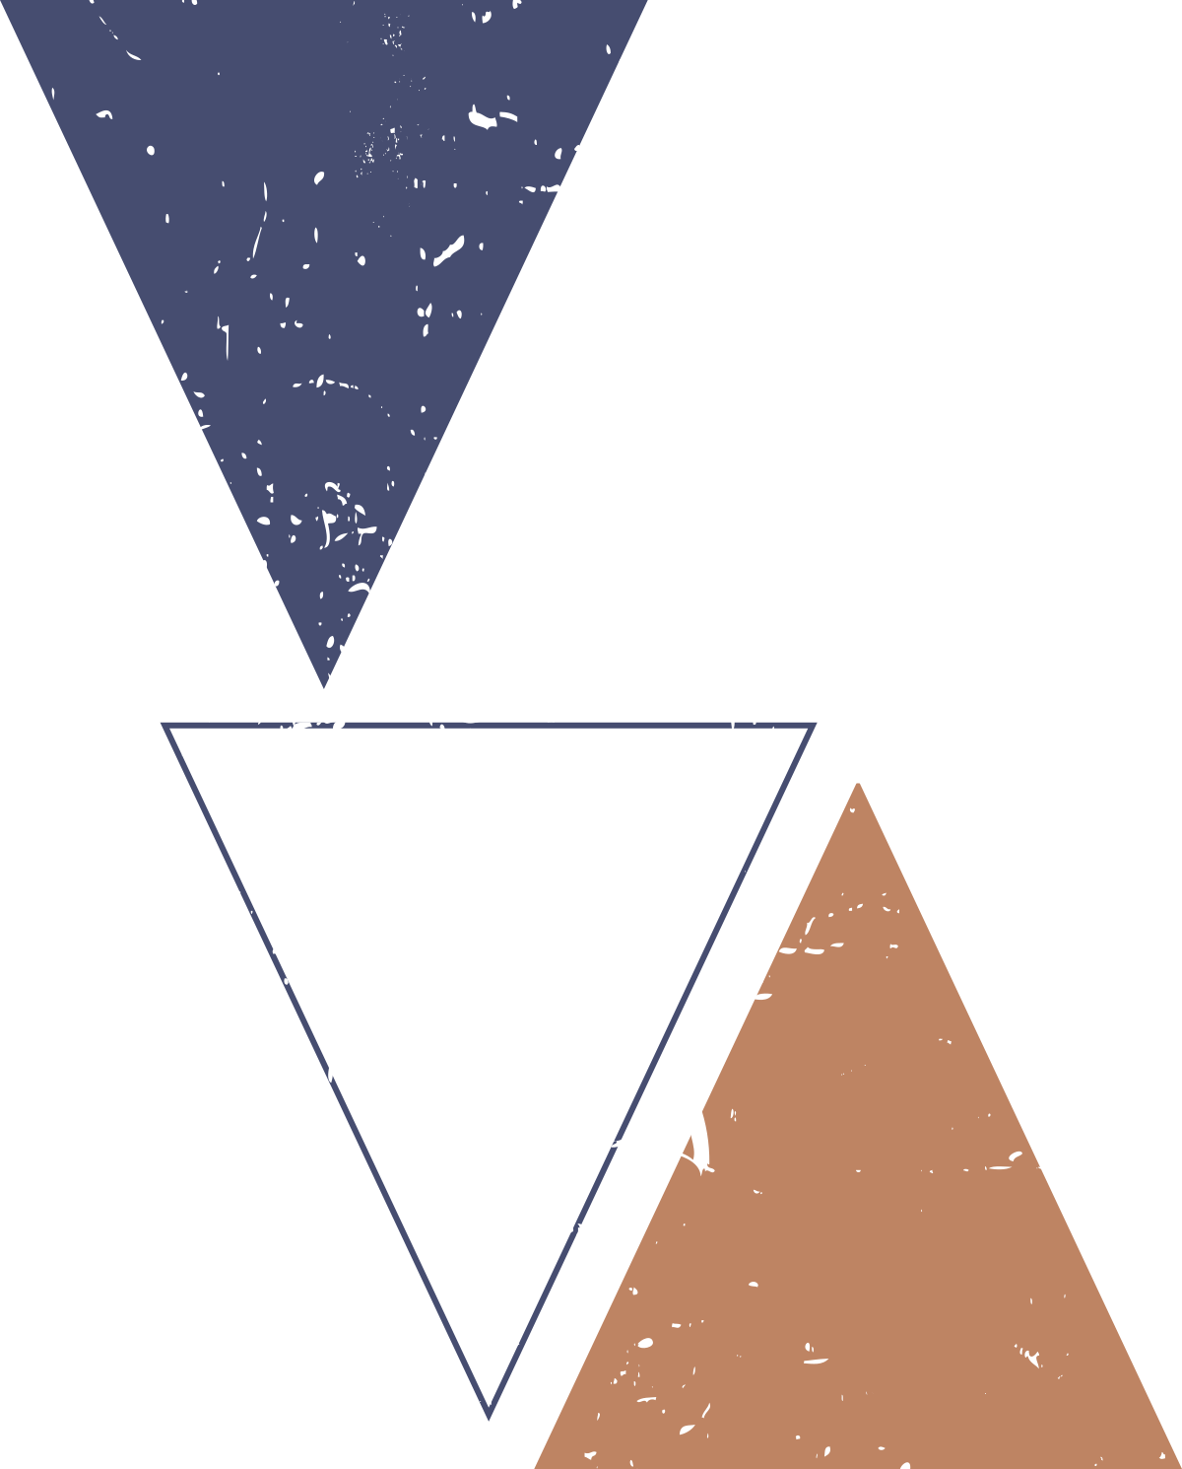



Digital Image processing - final project
Questionnaire Analysis

Slide 2
Contents :
Introduction
Methodology
Results
Conclusion
References

Slide 3

This project presents an innovative Questionnaire Analysis System that automates survey processing. Users can design, print, fill, and scan questionnaires, with the software accurately detecting marked answers and generating responses. Advanced image pre-processing ensures precise, error-free data collection, streamlining the entire process.
Introduction

Slide 4
Methodology :
describes the step-by-step approach used to develop the Questionnaire Analysis System, which automates the process of detecting and extracting answers from scanned questionnaires :

Slide 5
Methodology :
Step #1: Detect the exam in an image.
Step #2: Apply a perspective transform to extract the top-down, birds-eye-view of the exam.
Step #3: Extract the set of bubbles
Step #4: Sort the questions/bubbles into rows.
Step #5: Determine the marked answer for each row.
Step #6: Lookup the correct answer in our answer key to determine if the user was correct in their choice.
Step #7: Repeat for all questions in the exam.

Slide 6
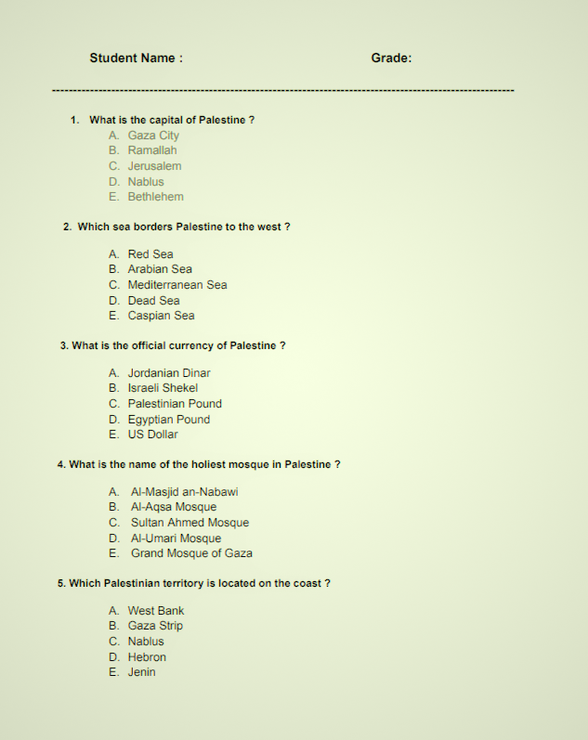
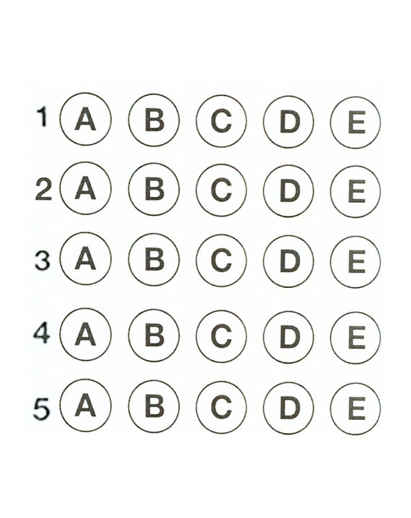
1. Designing the Questionnaire and bubble sheet :

Slide 7
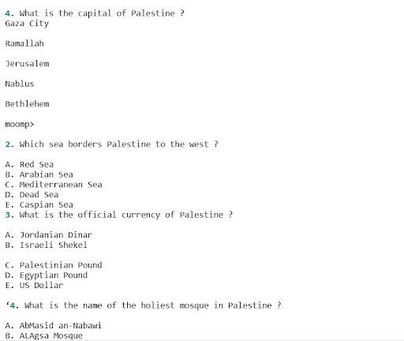
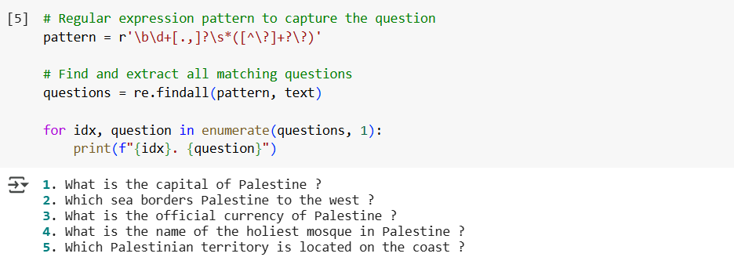
1. Designing the Questionnaire and bubble sheet :
Extracting and Detecting Questions : Using OCR (Optical Character Recognition), the text from the image was extracted (using pytesseract.image_to_string(image))
then using regular expressions to extract the question and store it in a table for display the final results

Slide 8

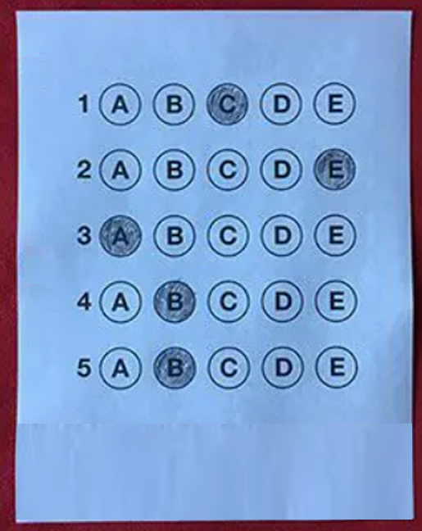
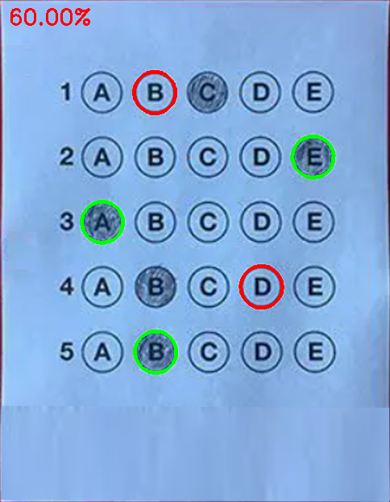
2. Scanning and Preprocessing the Image
The image underwent preprocessing to ensure
Grayscale Conversion
Blurring
Edge Detection
Orientation Correction

Slide 9
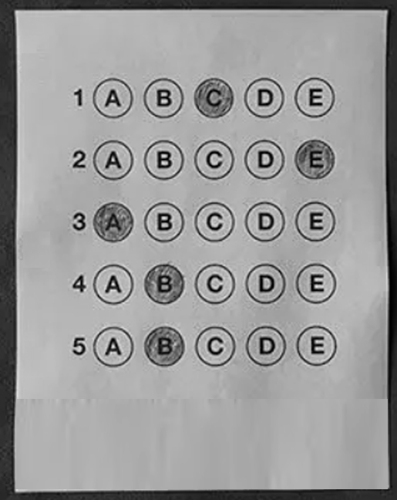
2. Scanning and Preprocessing the Image
The image underwent preprocessing to ensure
Grayscale Conversion

Slide 10

2. Scanning and Preprocessing the Image
The image underwent preprocessing to ensure
Grayscale Conversion
Blurring

Slide 11
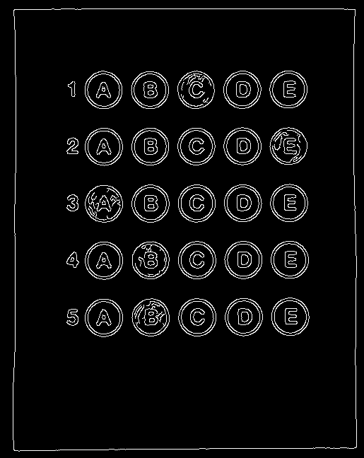
2. Scanning and Preprocessing the Image
The image underwent preprocessing to ensure
Grayscale Conversion
Blurring
Edge Detection

Slide 12
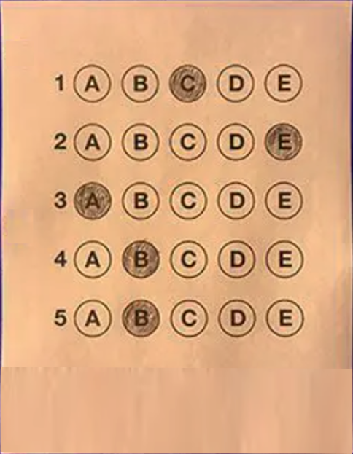
2. Scanning and Preprocessing the Image
The image underwent preprocessing to ensure
Grayscale Conversion
Blurring
Edge Detection
Orientation Correction

Slide 13
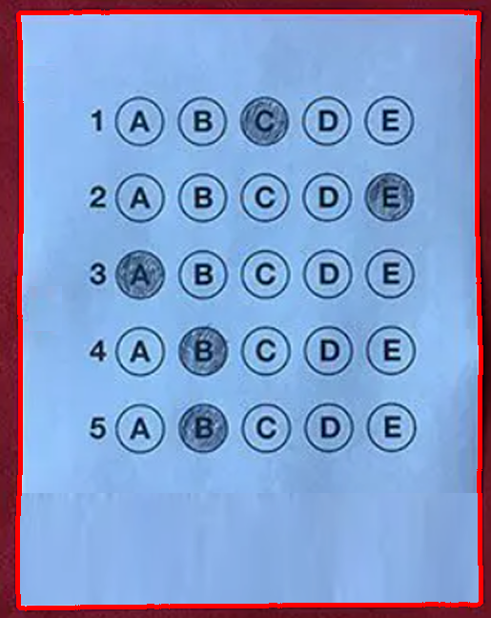
3. Extracting and Detecting User answers
1. Contours Detected

Slide 14
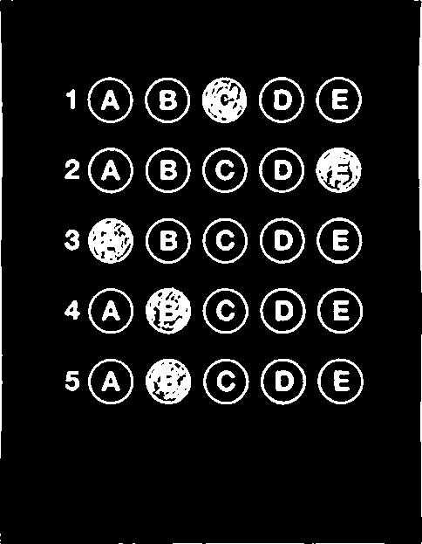
3. Extracting and Detecting User answers
1. Contours Detected
2. Thresholded Image

Slide 15
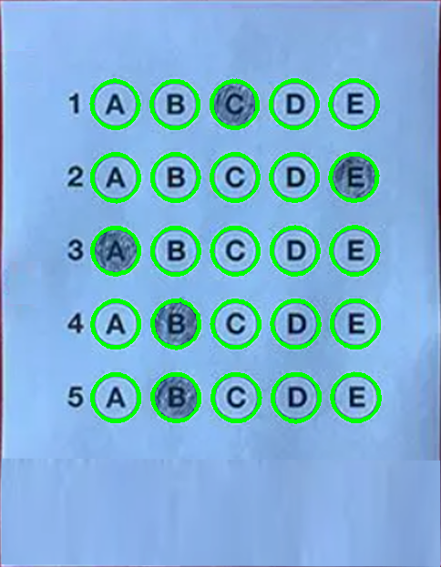
3. Extracting and Detecting User answers
1. Contours Detected
2. Thresholded Image
3. Question Contours

Slide 16
3. Extracting and Detecting User answers
1. Contours Detected
2. Thresholded Image
3. Question Contours
Ensure Correct Sorting (Final result)

Slide 17
Results:
The system accurately detects marked answers, automates grading, and provides visual feedback for easy result analysis. It ensures efficient, fast, and reliable performance for large-scale questionnaire evaluations.The system accurately detects marked answers, automates grading, and provides visual feedback for easy result analysis. It ensures efficient, fast, and reliable performance for large-scale questionnaire evaluations.

Slide 18
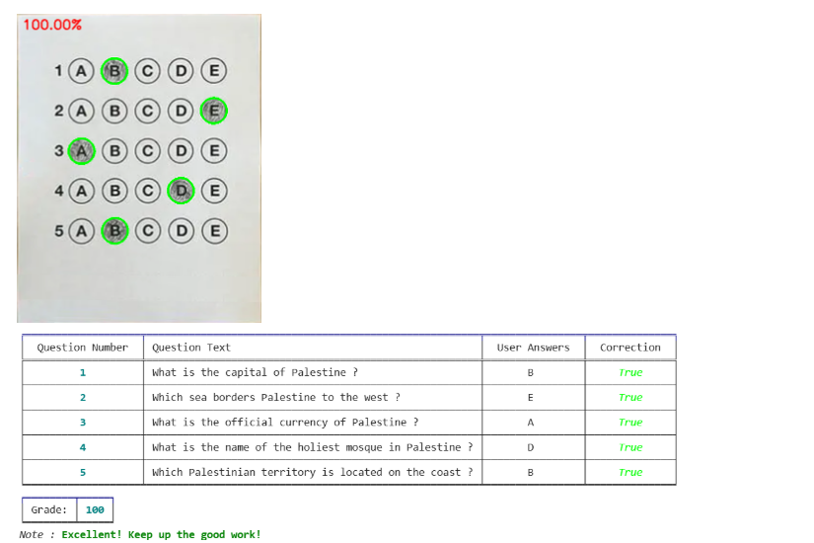
Results:
1- Test case 1 (full mark):
The system accurately detected all marked answers, resulting in a perfect score for the user. This highlights the software's efficiency and precision in processing questionnaire responses.

Slide 19
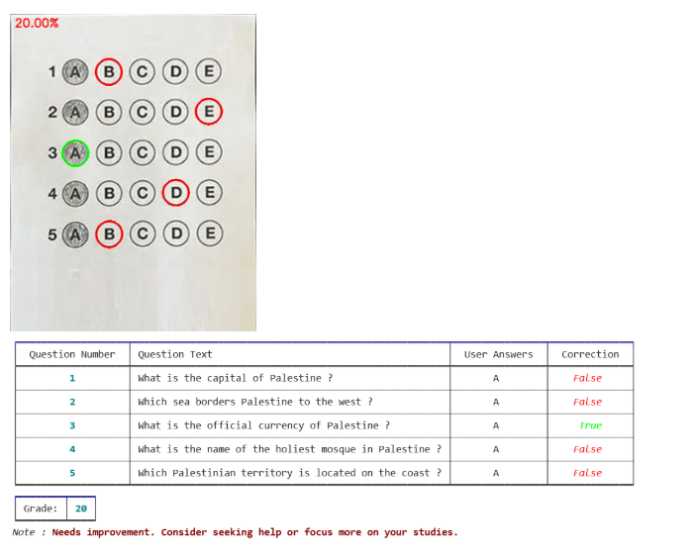
Results:
1- Test case 2 (low mark):
The system detected a few marked answers correctly, resulting in a score of 20%.

Slide 20
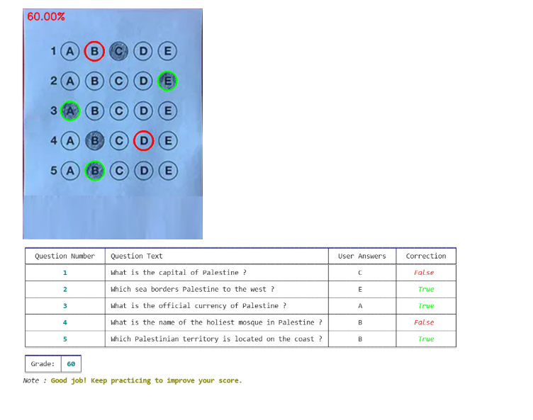
Results:
1- Test case 2 (intermidate mark):
The system detected most of the marked answers correctly, resulting in a score of 60%.

Slide 21
Conclusion :
The Questionnaire Analysis System automates answer detection, extraction, and evaluation from scanned forms using image processing techniques like edge detection and OCR. It enhances image quality, identifies marked responses, calculates scores, and outputs organized results, reducing manual work and improving accuracy for assessments and surveys.

Slide 22
References:
Python Code for OMR Answer Sheet Evaluation Using Deep Learning
optical mark recognition
Bubble sheet multiple choice scanner and test grader using OMR
Use pytesseract OCR to recognize text from an image
Tables — Rich 13.6.0 documentation

Slide 23
Thank You !

